Slide 1
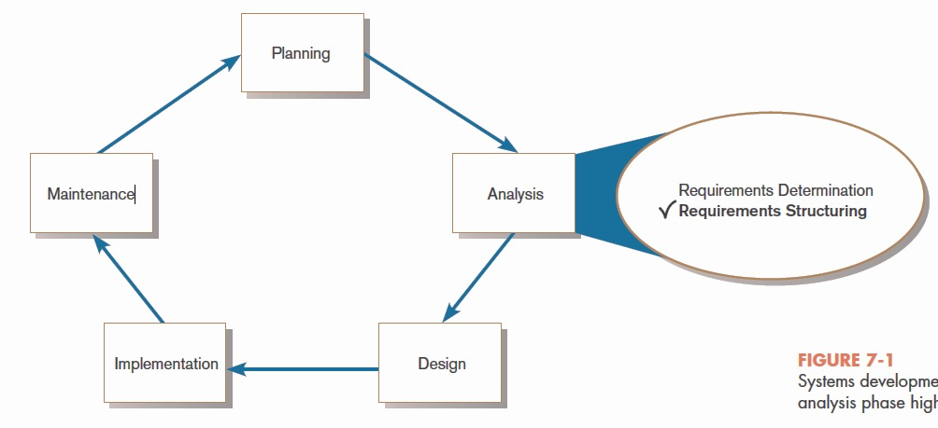
Process Modeling
FIGURE 7-1
Systems development life cycle with the analysis phase highlighted

Slide 2
Process Modeling (Cont.)
Graphically represent the processes that capture, manipulate, store, and distribute data between a system and its environment and among system components.
Utilize information gathered during requirements determination.
Model processes and data structures.

Slide 3
Deliverables and Outcomes
Context data flow diagram (DFD)
Scope of system
DFDs of current physical system
Adequate detail only
DFDs of current logical system
Enables analysts to understand current system

Slide 4
Deliverables and Outcomes (Cont.)
DFDs of new logical system
Technology independent
Show data flows, structure, and functional requirements of new system
Thorough description of each DFD component

Slide 5
Data Flow Diagramming Mechanics
Represent both physical and logical information systems
Only four symbols are used
Useful for depicting purely logical information flows
DFDs that detail physical systems differ from system flowcharts which depict details of physical computing equipment.

Slide 6
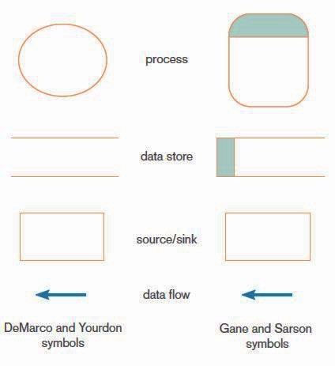
Definitions and Symbols
FIGURE 7-2
Comparison of DeMarco and Yourdon
and Gane and Sarson DFD symbol sets

Slide 7
Definitions and Symbols (Cont.)
Process: work or actions performed on data (inside the system)
Data store: data at rest (inside the system)

Slide 8
Definitions and Symbols (Cont.)
Source/sink: external entity that is the origin or destination of data (outside the system)
Data flow: arrows depicting movement of data

Slide 9
Developing DFDs
Context diagram is an overview of an organizational system that shows:
the system boundaries.
external entities that interact with the system.
major information flows between the entities and the system.
Note: only one process symbol, and no data stores shown

Slide 10
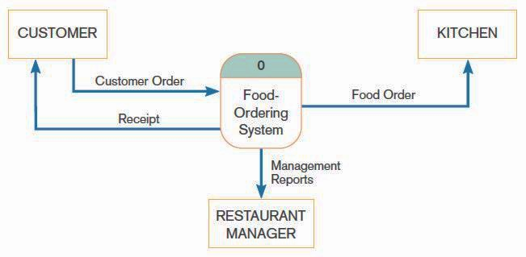
Context Diagram
FIGURE 7-4
Context diagram of Hoosier Burger’s food-ordering system

Slide 11
Developing DFDs (Cont.)
Level-0 diagram is a data flow diagram that represents a system’s major processes, data flows, and data stores at a high level of detail.
Processes are labeled 1.0, 2.0, etc. These will be decomposed into more primitive (lower-level) DFDs.

Slide 12
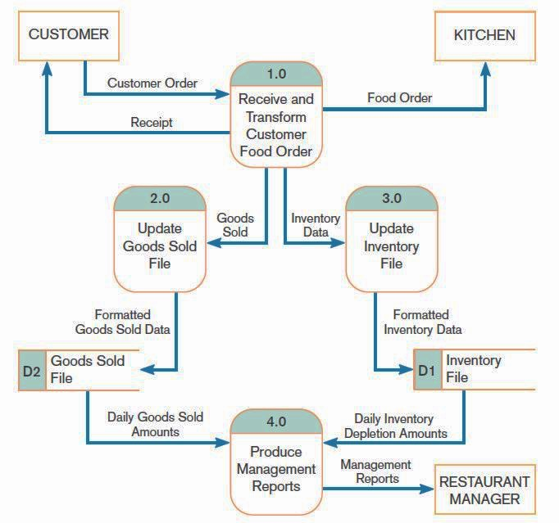
Level-0 Diagram
FIGURE 7-5
Level-0 DFD of Hoosier Burger’s food-ordering system

Slide 13
Data Flow Diagramming Rules
There are two DFD guidelines that apply:
The inputs to a process are different from the outputs of that process.
Processes purpose is to transform inputs into outputs.
Objects on a DFD have unique names.
Every process has a unique name.

Slide 14
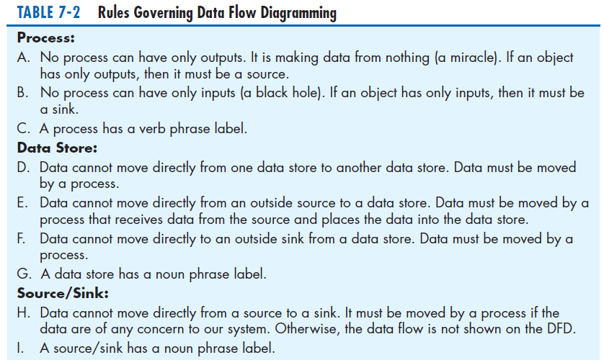
Data Flow Diagramming Rules (Cont.)
TABLE 7-2 Rules Governing Data Flow Diagramming

Slide 15
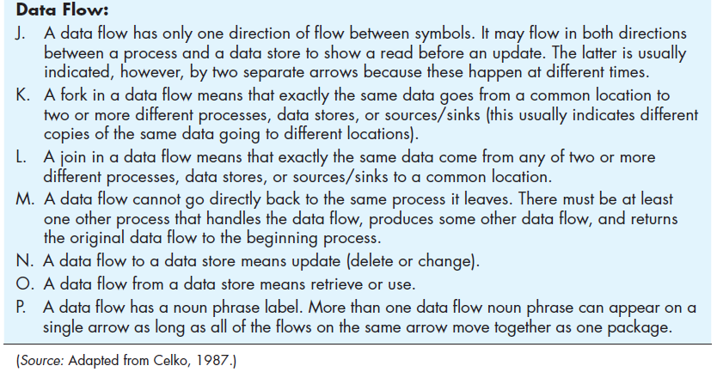
Data Flow Diagramming Rules (Cont.)
TABLE 7-2 Rules Governing Data Flow Diagramming (cont.)

Slide 16
Decomposition of DFDs
Functional decomposition is an iterative process of breaking a system description down into finer and finer detail.
Creates a set of charts in which one process on a given chart is explained in greater detail on another chart.
Continues until no sub-process can logically be broken down any further.

Slide 17
Decomposition of DFDs (Cont.)
Primitive DFD is the lowest level of a DFD.
Level-1 diagram results from decomposition of Level-0 diagram.
Level-n diagram is a DFD diagram that is the result of n nested decompositions from a process on a level-0 diagram.

Slide 18
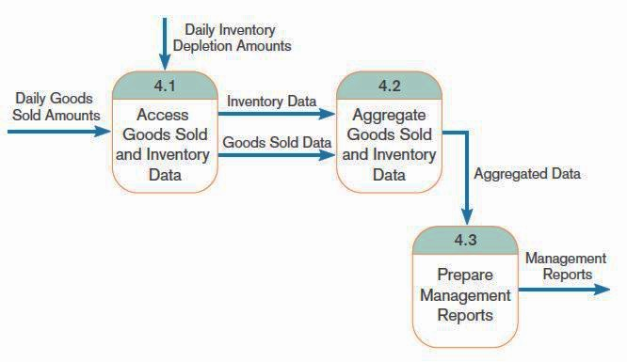
Level-1 DFD
FIGURE 7-8
Level-1 diagram showing the decomposition of Process 4.0 from the level-0 diagram for Hoosier Burger’s food-ordering system
Level-1 DFD shows the sub-processes of one of the processes in the Level-0 DFD.
This is a Level-1 DFD for Process 4.0.
Processes are labeled 4.1, 4.2, etc. These can be further decomposed in more primitive (lower-level) DFDs if necessary.

Slide 19
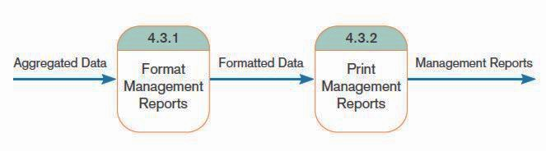
Level-n DFD
FIGURE 7-9
Level-2 diagram showing the decomposition of Process 4.3 from the level-1 diagram for Process 4.0 for Hoosier Burger’s food-ordering system
Level-n DFD shows the sub-processes of one of the processes in the Level n-1 DFD.
This is a Level-2 DFD for Process 4.3.
Processes are labeled 4.3.1, 4.3.2, etc. If this is the lowest level of the hierarchy, it is called a primitive DFD.

Slide 20
Balancing DFDs
Conservation Principle: conserve inputs and outputs to a process at the next level of decomposition
Balancing: conservation of inputs and outputs to a data flow diagram process when that process is decomposed to a lower level

Slide 21
Balancing DFDs (Cont.)
Balanced means:
Number of inputs to lower level DFD equals number of inputs to associated process of higher-level DFD
Number of outputs to lower level DFD equals number of outputs to associated process of higher-level DFD

Slide 22
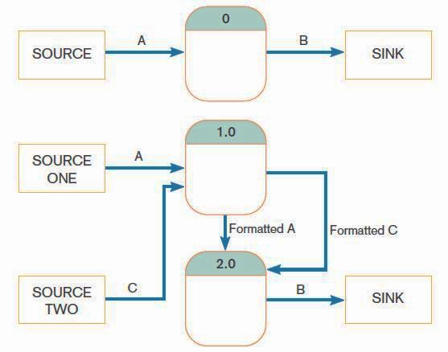
Balancing DFDs (Cont.)
FIGURE 7-10 An unbalanced set of data flow diagrams
(a) Context diagram
1 input
1 output
This is unbalanced because the process of the context diagram has only one input but the Level-0 diagram has two inputs.
(b) Level-0 diagram
2 inputs
1 output

Slide 23
Balancing DFDs (Cont.)
Data flow splitting is when a composite data flow at a higher level is split and different parts go to different processes in the lower level DFD.
The DFD remains balanced because the same data is involved, but split into two parts.

Slide 24
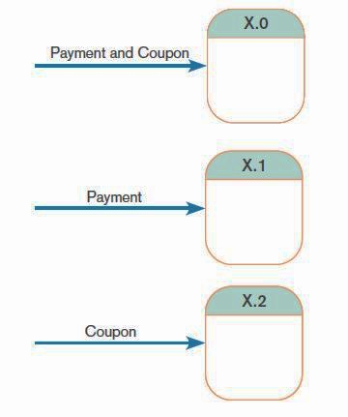
Balancing DFDs (Cont.)
FIGURE 7-11
Example of data flow splitting
(a) Composite data flow
(b) Disaggregated data flows

Slide 25
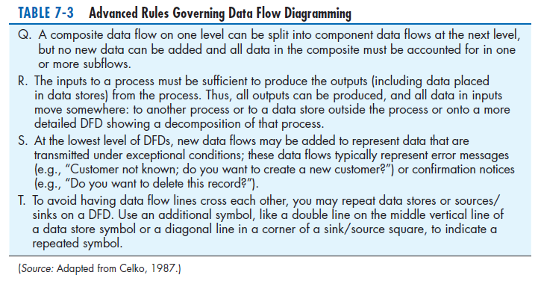
Balancing DFDs: More DFD Rules

Slide 26
Four Different Types of DFDs
Current Physical
Process labels identify technology (people or systems) used to process the data.
Data flows and data stores identify actual name of the physical media.
Current Logical
Physical aspects of system are removed as much as possible.
Current system is reduced to data and processes that transform them.

Slide 27
Four Different Types of DFDs (Cont.)
New Logical
Includes additional functions
Obsolete functions are removed.
Inefficient data flows are reorganized.
New Physical
Represents the physical implementation of the new system

Slide 28
Guidelines for Drawing DFDs
Completeness
DFD must include all components necessary for system.
Each component must be fully described in the project dictionary or CASE repository.
Consistency
The extent to which information contained on one level of a set of nested DFDs is also included on other levels

Slide 29
Guidelines for Drawing DFDs (Cont.)
Timing
Time is not represented well on DFDs.
Best to draw DFDs as if the system has never started and will never stop.
Iterative Development
Analyst should expect to redraw diagram several times before reaching the closest approximation to the system being modeled.

Slide 30
Guidelines for Drawing DFDs (Cont.)
Primitive DFDs
Lowest logical level of decomposition
Decision has to be made when to stop decomposition

Slide 31
Guidelines for Drawing DFDs (Cont.)
Rules for stopping decomposition
When each process has been reduced to a single decision, calculation or database operation
When each data store represents data about a single entity

Slide 32
Guidelines for Drawing DFDs (Cont.)
Rules for stopping decomposition, cont.
When the system user does not care to see any more detail
When every data flow does not need to be split further to show that data are handled in various ways

Slide 33
Guidelines for Drawing DFDs (Cont.)
Rules for stopping decomposition, cont.
When you believe that you have shown each business form or transaction, online display and report as a single data flow
When you believe that there is a separate process for each choice on all lowest-level menu options

Slide 34
Using DFDs as Analysis Tools
Gap Analysis is the process of discovering discrepancies between two or more sets of data flow diagrams or discrepancies within a single DFD.
Inefficiencies in a system can often be identified through DFDs.

Slide 35
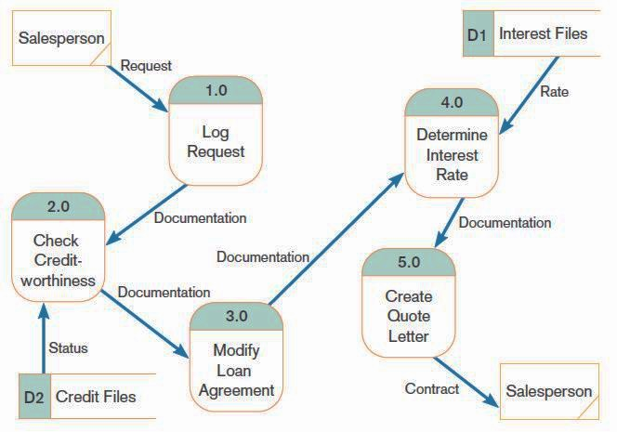
Using DFDs in BPR
FIGURE 7-16
IBM Credit Corporation’s primary work process before BPR
(Source: Based on Hammer and Champy, 1993.)

Slide 36
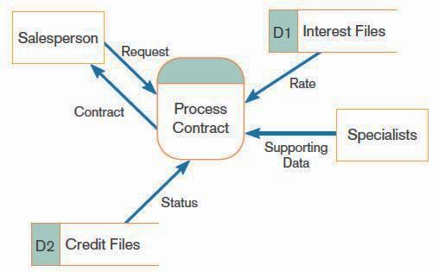
Using DFDs in BPR (Cont.)
FIGURE 7-17
IBM Credit Corporation’s primary work process after BPR
(Source: Based on Hammer and Champy, 1993.)

Slide 37
Modeling Logic with Decision Tables
Decision table: a matrix representation of the logic of a decision which specifies the possible conditions for the decision and the resulting actions
Best used for complicated decision logic

Slide 38
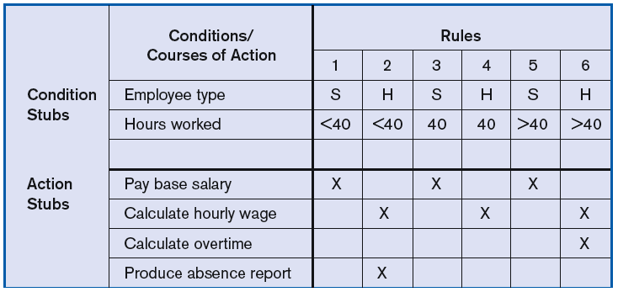
Modeling Logic with Decision Tables (Cont.)
FIGURE 7-18
Complete decision table for payroll system example

Slide 39
Modeling Logic with Decision Tables (Cont.)
Condition stubs: that part of a decision table that lists the conditions relevant to the decision
Action stubs: that part of a decision table that lists the actions that result for a given set of conditions

Slide 40
Modeling Logic with Decision Tables (Cont.)
Rules: that part of a decision table that specifies which actions are to be followed for a given set of conditions
Indifferent condition: in a decision table, a condition whose value does not affect which actions are taken for two or more rules

Slide 41
Modeling Logic with Decision Tables (Cont.)
Procedure for Creating Decision Tables
Name the condition and the values that each condition can assume.
Name all possible actions that can occur.
List all possible rules.
Define the actions for each rule.
Simplify the table.

Slide 42
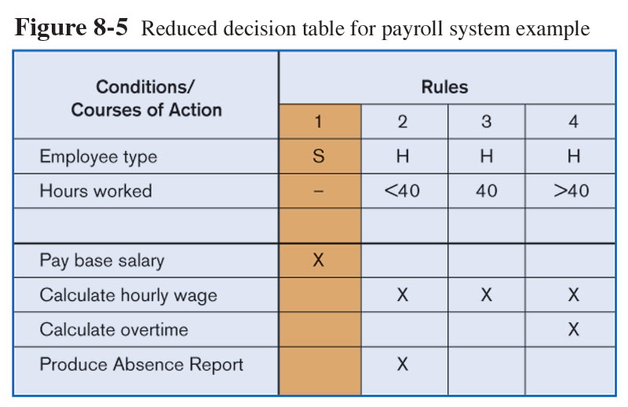
Modeling Logic with Decision Tables (Cont.)
FIGURE 7-19
Reduced decision table for payroll system example

Slide 43
Electronic Commerce Application: Process Modeling using Data Flow Diagrams
Process modeling for Pine Valley Furniture’s WebStore
Completed JAD session
Began translating the WebStore system structure into data flow diagrams
Identified six high-level processes

Slide 44
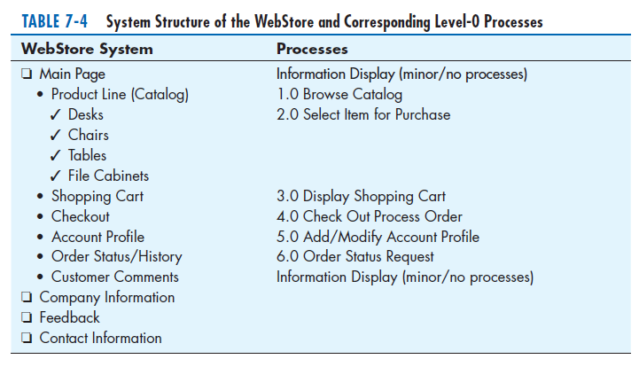
Electronic Commerce Application: Process Modeling using Data Flow Diagrams (Cont.)

Slide 45
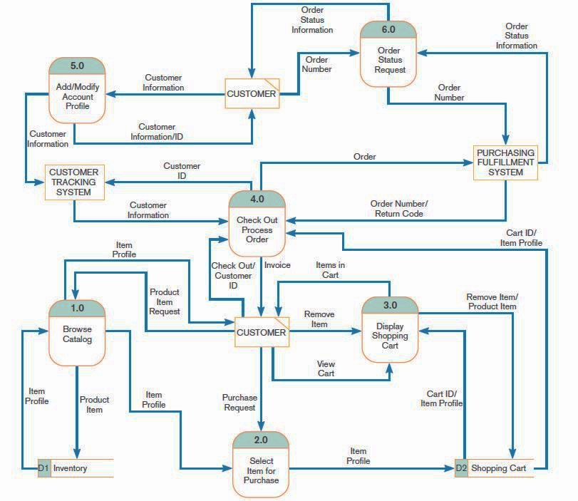
Electronic Commerce Application: Process Modeling using Data Flow Diagrams
FIGURE 7-22
Level-0 data flow diagram for the
WebStore

Slide 46
Summary
In this chapter you learned how to:
Understand logical process modeling via data flow diagrams (DFDs).
Draw data flow diagrams of well-structured process models.
Decompose data flow diagrams into lower-level diagrams.

Slide 47
Summary (Cont.)
Balance high-level and low-level data flow diagrams.
Use data flow diagrams for analyzing information systems.
Use decision tables to represent the logic of choice in conditional statements.

